Slide 1
Kivy
Python everywhere

Slide 2
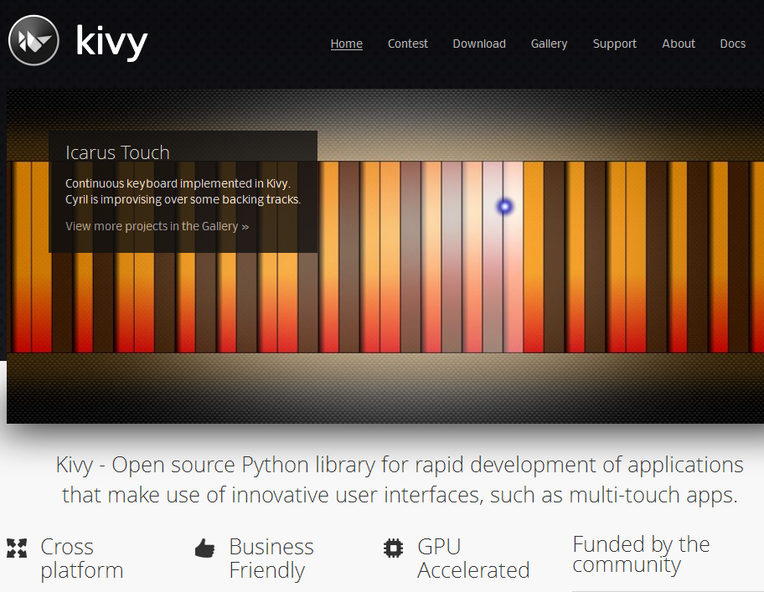
What is Kivy?

Slide 3
Why choose Kivy? Official reasons
It's Fresh
Unqiue and pretty, transitions and animations make it fluid, responsive and interactive.
Note:
Kivy does not adopt your native OS look and feel. It gives you your own, consistent UI, everywhere.
Fast
Uses Cython, so your code is compiled to native C.
Extensive and highly optimized use of the GPU.
Flexible
OOP and event driven
Uses and provides proven design pattens:
Observer Pattenr
Single Responsivbility Principle
Separation of Converns
Separation of login and UI

Slide 4
Why choose Kivy? The real reasons
It's awesome
Kivy is much more that just a complete widgets toolkit. It provides:
- a complete Python standard library (pyython-for-android, python-for-ios)
- a rich set of libraries (Factory, Clock, Atlas, Logger etc)
- OS and device abstraction (Metrics, InputProvers, Core providers)
- a powerful property/event dispatching mechanism
- a set of modules for assisting in developing and debugging
- extensibility though kivy exentions and the Kivy garden
- it's stable, proven, well designed and just damn sexy

Slide 5
Why choose Kivy? More reasons
Kivy provides thoughful, easy-to-use functionality to allows costly IO to be done in background threads(using callbacks).
This makes it easy to ensure your UI stays responsive without worrying about threading.
- UrlRequest(url, on_success=None, on_redirect=None, ...)
- AsyncImage().source = url
- Animation
anim = Animation(x=50, y=200, duration=2)
anim.bind(on_complete=callback)
anim.start(widget)
Firstly, lets go into the details of what makes kivy different.
To do that, it's best to first understand how the core design choices have shaped Kivy's architecture.

Slide 6
Difference 1: Optimized for the GPU
Drawing is done by OpenGL, and OpenGL is NOT a canvas!
Your Python runs on the CPU, but OpenGL runs on the GPU.
OpenGL is a collections of instruction groups, not an image.
When your widget properties change, the instruction sets do not.
Updating these instructions sets whenever your Python obect changes? Horribly inefficient.
Solution?
Observe!

Slide 7
Difference 1: The gotcha
Why does my widget not move?
Because you are changing it's Python properties, not it's OpenGL drawing instructions.
First solution: bind manually in Python.
Second solution: define your UI using the KV language.
Solutions are easy, the trick is knowing why.

Slide 8
Difference 1: The solutions
You can bind and listen for these changes manually in Python.
widget.bind(on_pos=callback, on_size=callback)
But that quickly becomes clumsy. Kivy offers the KV lang as a better solution.
Not another language?
Yes, but it's a good solution and a best practise for many reasons:
- performs bindings automagically for you.
- separates UI from code/logic.
- gives an clear picture of your widget heirarchy.
- once learnt, it's much faster to compose a UI.
Examples later, but first, another reason Kivy is different.

Slide 9
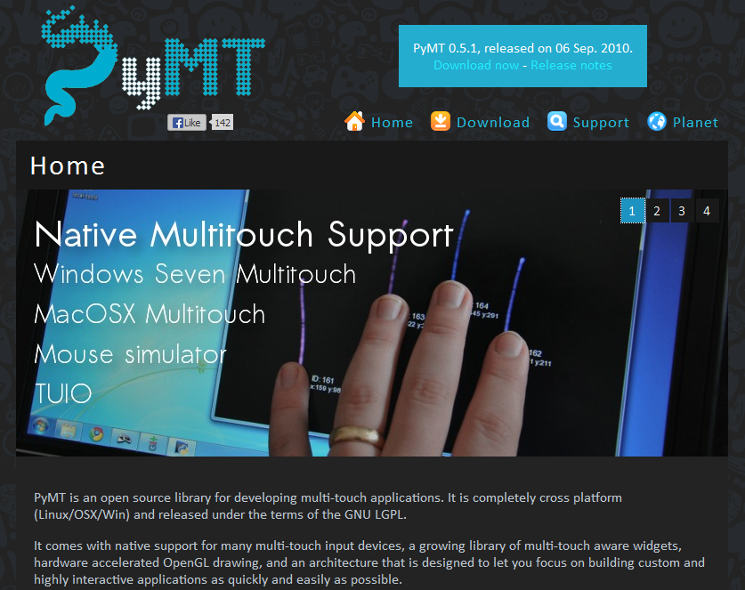
Difference 2: Built for multi-touch
Kivy brings years of multi-touch experience with it.
Kivy is PyMT, reborn, optimized and implemented in OpenGL ES, the subset of Open GL available on mobile devices. It brings with a rich pedigree of multi-touch experience.

Slide 10
Difference 2: The gotcha
But widget A is inside widget B! Why on earth is it in the bottom left corner?
Firstly, bottom left is (0,0), not top left.
Secondly, the widgets heirarchy is NOT a visaul container heirarchy: it's an event bubbling heirarchy.
Containers are used for layout, but widgets are not artificially constrained to areas.
This allows for total control of layout and gives you full control of the entire screen.
It also facilitates seamless layering. Just pop in another layout, and you can seemlessly float anything anywhere.

Slide 11
Difference 2: Another gotcha
What? Wherever I click, all the widgets "on_touch_down" events fire?
Don't think windows and rectangles! That 's very 95.
The idea of rectangular widget with pre-defined borders breaks down in a touch enviroment
Example.
You want a widget to receive a swipe in event.
By definition, that event begins outside of the widget.
In a touch envronment, widgets need new degrees of freedom to monitor input.
Kivy widgets are not limited by their size and position in either output or input. These are just properties!
Yes please! Give me the power!
So how do widgets get touch events? Observe!

Slide 12
Difference 2: The solution
Apply the 'Observer Pattern'
By binding to specific events, any widget can react to almost any event with minimal overhead.
This does not prescribe how events are handled.
It allows total flexibility and puts you in control.
It facilitates decoupling.
It facilitates separation of concerns.
It avoids state variables and object references.

Slide 13
Let's get dirty
Almost all of the challenges Kivy faces are solved in an elegant and consistent way: observing.
Ironically, the solutions actually improve the framework and increase it's flexibility.
And it only gets more awesome as you get deeper.
But enough bluster.
Let's get dirty! Let's dive into some details;-)

Slide 14
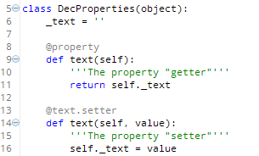
Python Properties using Decorators
Okay, so a hidden variable.
Err...@text.setter? Pretty cryptic.
And two "text" methods?
Isn't there a better way?

Slide 15
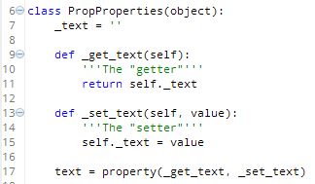
Python Properties using property()
Gee, 4 things.
Okay, still a hidden variable.
Gee, a "getter", a "setter" and then something to combine them into a property?
Isn't there a better way?

Slide 16


Python Properties using Kivy
Yes, welcome to the Kivy awesome!
It looks like a "static" class method, but Kivy magically bind values to each instance.
Want to watch changes?

Slide 17
Touch made easy
Kivy's rich pedigree of experience shows.
Touch = mouse. Touch is just richer i.e. has some extra properties.
The Touch object is a rich representation of the entire touch event.
It is passed into all of these events:
on_touch_down
on_touch_move
on_touch_up
The 'on_touch-down' event is dispatched to every widget that requests to listen.
If the widget wishes to monitor the event, it can "grab" it here and will then receive all subsequent "touch_move" and "touch_up" events".

Slide 18
The Touch Object
The touch object is a specialized instance of the MotionEvent class.
These are ojects generated by InputProviders. Nicely abstracted and easy to use.
Here are some of the Touch object's interesting propeties:
'apply_transform_2d', 'clear_graphics', 'copy_to', 'depack', 'device', 'distance', 'double_tap_time', 'dpos', 'dsx', 'dsy', 'dsz', 'dx', 'dy', 'dz', 'grab', 'grab_current', 'grab_exclusive_class', 'grab_list', 'grab_state', 'id', 'is_double_tap', 'is_mouse_scrolling', 'is_touch', 'is_triple_tap', 'move', 'opos', 'osx', 'osy', 'osz', 'ox', 'oy', 'oz', 'pop', 'pos', 'ppos', 'profile', 'psx', 'psy', 'psz', 'push', 'push_attrs', 'push_attrs_stack', 'px', 'py', 'pz', 'scale_for_screen', 'shape', 'spos', 'sx', 'sy', 'sz', 'time_end', 'time_start', 'time_update', 'triple_tap_time', 'ud', 'uid', 'ungrab', 'update_graphics', 'update_time_end', 'x', 'y', 'z']
As you can see, the Touch object maintain detailed information about the entire interaction, so we dont' need to.
Special mention: notice the Z axis? Kivy also supports 3D gesture input, currently via the Leap Motion and Microsoft Kinect.

Slide 19
Grabbing a touch
You can grab a touch if you absolutly want to receive these events:
on_touch_move()
on_touch_up()
Touch events normally bubble through the widget hierarchy until one of those methods returns True, indicating the event has been handled.
Grabbing a touch ensures you get all it's subsequent events.
Very powerful: it allows widgets to receive events independent of context.
Let's look at an example.

Slide 20
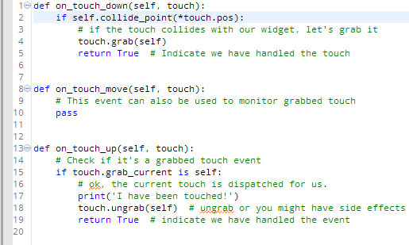
Grabbing a Touch: an example

Slide 21
From Touch to Gestures
Touch is great, but how do we use it for detecting gestures?
Converting input points to gestures is, err, challenging i.e. frikken difficult.
But don't worry, Kivy does it all for you.
Let's look at an example.

Slide 22
From Touch to Gestures
Touch is great, but how do we use it for detecting gestures?
Converting input points to gestures is, err, challenging i.e. frikken difficult.
But don't worry, Kivy does it all for you.
Let's look at an example.

Slide 23
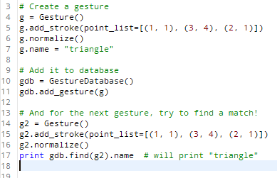
Gesture recognition
Easy to access Gesture databases built in, with normalization.
But wait, it get's even easier!

Slide 24
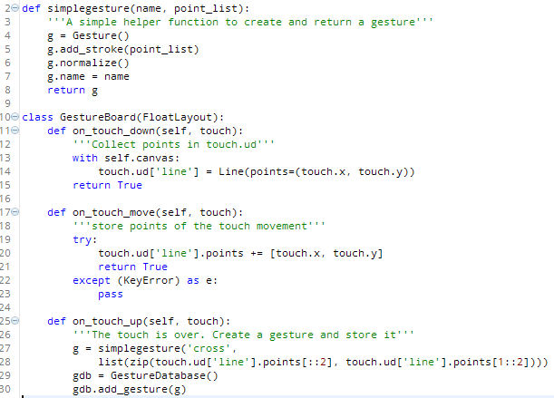
Recording Gestures
This means you can record gestures and store them for later comparison in input.
Makes creating a gesture vocabulary dead simple.

Slide 25
The Widgets
We will launch the Kivy Showcase demo from the Kivy Windows portable package.
Self-contained: can be run on systems irrespective on their current Python installation.
Contains: all Kivy source code, examples and a complete Cython install with all libraries.
About 75mb zipped, but your installation can be much smaller if packaged with PyInstaller.

Slide 26
Other Notable Widgets
The ScreenManager
By default, apps are one 'Screen'.
The ScreenManager allows you to create multiple screens and switch between them.
You get a whole lot of beautiful, fluid transitions for free:
SlideTransition - slide screen in/out, from any direction
SwapTransition - implementation of the iOS swap transition
FadeTransition - shader to fade in/out the screens
WipeTransition - shader to wipe from right to left the screens

Slide 27
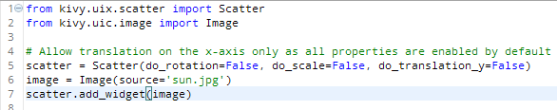
Other Notable Widgets
The Scatter
The Scatter is used to build interactive widgets that can be translated, rotated and scaled with two or more fingerss on a multitouch system.
It has as its own matrix transformations which makes possible to perform the rotation /
scaling / translation over the entire child tree without changing their properties.

Slide 28
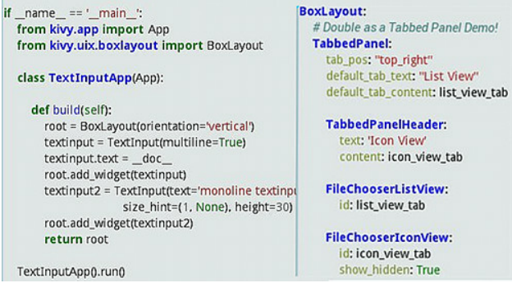
Other Notable Widgets
The CodeInput
Provides a box of editable highlited text.
It supports all the features supported by the TextInput.
Proivides Code highliting for languages supported by pygments along with KivyLexer for KV Language highliting.

Slide 29
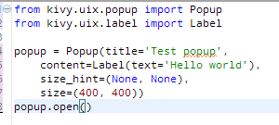
Other Notable Widgets
The Popup
Creates modal popups.
Uses lighbox effect to grey our background window.
Very flexible: you pass it a 'content' property which can contain any widgets or containers.

Slide 30
Other Notable Widgets
Layouts
Layouts - the proper way to handle UI.
Provide very fluid and elegant mechanisms to scale UI for different screen resolutions and densities.
Each works differently, but generally use 'pos_hint' and 'size_hint' to request placement.

Slide 31
Customizing Widgets
Many options.
- create you own widget inheriting the EventDispatcher.
- subclass and alter (widget.background_down, widget.background_up etc).
- replace the kivy atlas with your own atlas image.

Slide 32
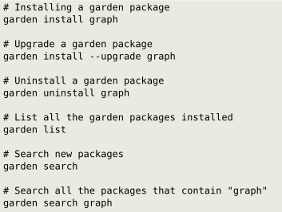
The Kivy Garden
Not every widget you want can or should be included with Kivy.
The Garden provides a repository of additional widgets that anyone can contribute to.
Maintained by the community, not the Kivy core team.
Trivially to use: Kivy ships with a garden tool.

Slide 33
The Widgets in the Garden
Currently, widget in the Garden include graphs, custom spinners, navigationdraws, DatePickers etc.
Some notable ones:
- CEPython – an embedded Chromium browser using CEFPython (not yet stable)
- Roulette – provedes a way of selecting values like iOS and android date pickers.
- Filechooserthumbview - FileChooserThumbView for Kivy.
- Particlesystem – A particle engine for Kivy framework
And many more...

Slide 34
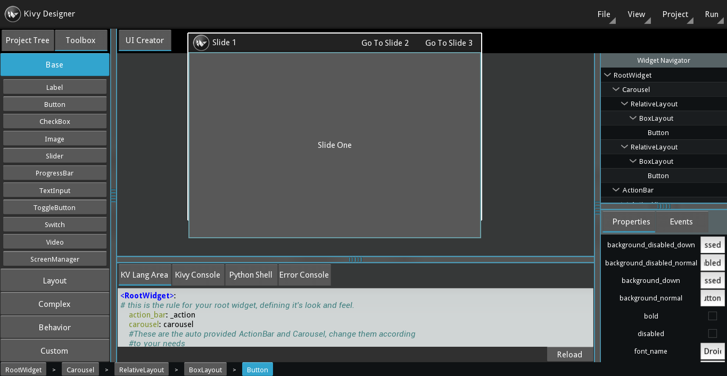
Something else exciting
Not in the Garden but another great project : The Kivy-Designer – A WYSIWYG UI designer.

Slide 35
Kivy Modules
Kivy provides some amazing tools for development and debugging.
They are easy to use and activate
You can also roll your own (simple module with start(win, ctx) and stop(win, ctx) methods)
They include:
touchring: circles each touch.
monitor: shows a small FPS and activity graph.
keybinding: bind keys to actions, such as a screenshot.
recorder: record and playback events.
screen: emulate different screens.
inspector: examine your widget heirarchy
webdebugger: realtime examination of your app internals via a web browser

Slide 36
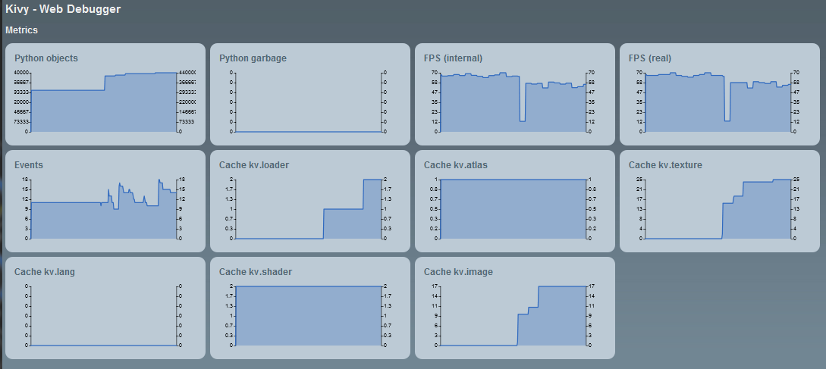
Webdebugger Module
Provides realtime inspection of your apps internals.
It doe sthis usesing an embedded micro-webframework called flask + embedded jQuery.

Slide 37
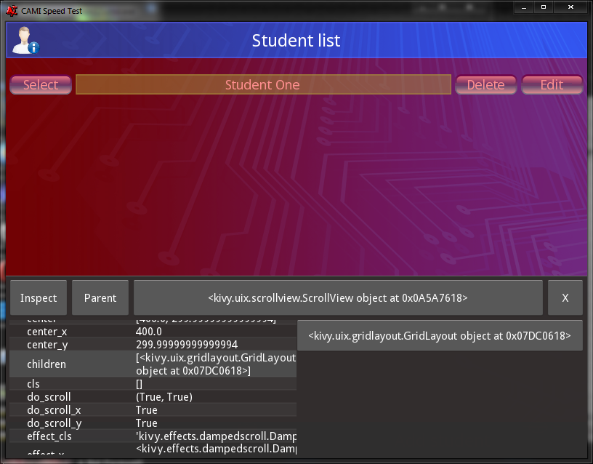
Inspector Module
The inspector allows for interactively travesing your entire widget heirarchy.
It provides a complete analysis of each widget, including it's children.

Slide 38
Libraries
Kivy provides a rich set of libraries offering extra functionality.
- Animations and transitions, Atlas, Clock, Factory, Logger, Metrics, Vector, Adaptors, Effects (ScrollEffect, DampedScrollEffect, OpacityScrollEffect + garden + roll you own), Gesture recording, playback and recognition, Shader and Stencil instructions, asynchronous data loader, Utils, UrlRequest, ReStructuredText, VKeyBoard
- Core abstractions including:
Audio, Camera, Clipboard, OpenGL, Image, Spelling, Text, Video, Window, InputProviders.
Let's quickly look as some interesting libraries.

Slide 39
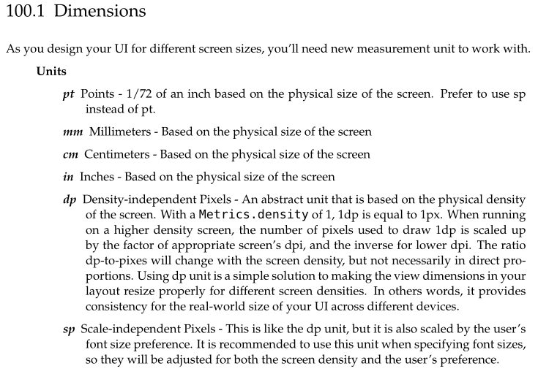
Metrics
Metrics provide a seamless, powerful way to work with different screens and resolutions

Slide 40
Font sizing done right
Font size are challenging on almost all Operating Systems.
Points? So, how does that relate to my widget height? Oh, I must calculate actual width and height this API or that one....
In Kivy, font_size is the height of the font and be set using any metric.
It's as simple as that.

Slide 41

Screen metrics done right
Screens feature 3 core properties that determine how things appear.
All of these are trivial to access via the metrics module and trivial to log for later emulation.

Slide 42
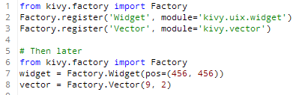
The Factory
Screens feature 3 core properties that determine how things appear.
All of these are trivial to access via the metrics module and trivial to log for later emulation.
Any class names registered are then creatable and recognized in your KV files/strings.

Slide 43
The Utils Library
Kivy provides a few handy, general purpose utilities.
platform() # Returns one of: win, linux, android, macosx, ios, unknown.
intersection(set1, set2) # return intersection between 2 list
difference(set1, set2)
QueryDict # A dict() that can be queried with dot.
escape_markup(text) # Escape markup characters found in the text.
#Intended to be used when markup text is activated on the Label:

